Slide 1

Water Quality Tester
Arduino Based

Slide 2
Product
Our product will offer the first portable water quality tester. We created “Arduino Based Water Quality Tester” in terms of water tester, where that you can test the quality of water using this portable or tumbler where that the result will appear in screen after you test the water and it will indicate if the water is safe to drink or not safe to drink.

Slide 3
Market Size
Our aim to sell our products are hikers, mountain climbing, bikers and campers so that they all know if the water is safe.

Slide 4
Market Strategy
JAB Inc. will be promoting "Arduino Based Water Quality Tester" through social media. The team plan to upload a video trailer in YouTube and Facebook to attract potential costumer since Facebook nowadays are the most common place where advertising tourism is very effective. JAB Inc. value customers' feedbacks and use it to further improve the product quality and experience.

Slide 5
Competitive Advantage
JAB Inc.’s Arduino Based Water Tester is the first water tester which can be portable. Arduino Based Water Tester is very unique and useful because it can really help the user to aware if the water is safe for drinking. Our company values user’s comments and suggestions to make the product better.

Slide 6
Cost
The cost of our product will solely depend on the price of the device.

Slide 7
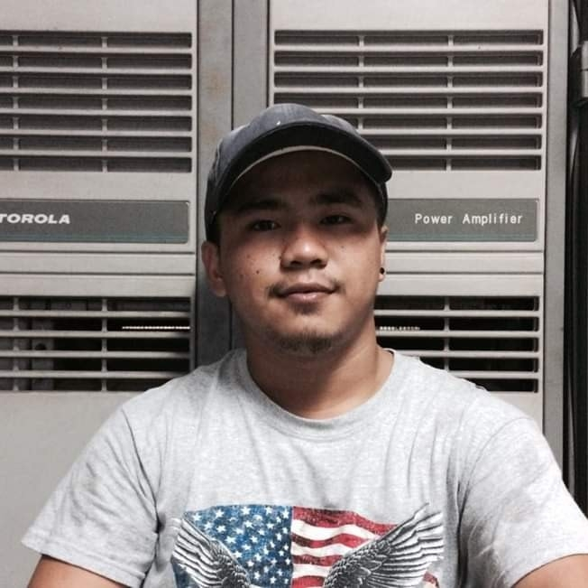
Management Team
Benny Pañares
-Age: 20
-Civil Status: Single
-Position: Chief Executive Officer

Slide 8

Management Team
Ahrve Kim E. Jabonillo
-Age: 20
-Civil Status: Single
-Position: Chief Technology Officer

Slide 9

Management Team
Jucel Gadiano
-Age: 21
-Civil Status: Single
-Position: Chief Operating Officer

